Slide 1
Flavor Graph: a large-scale food-chemical graph for generating food representations and recommending food pairings
2025/08/05, SONG DONGCHAN

Slide 2
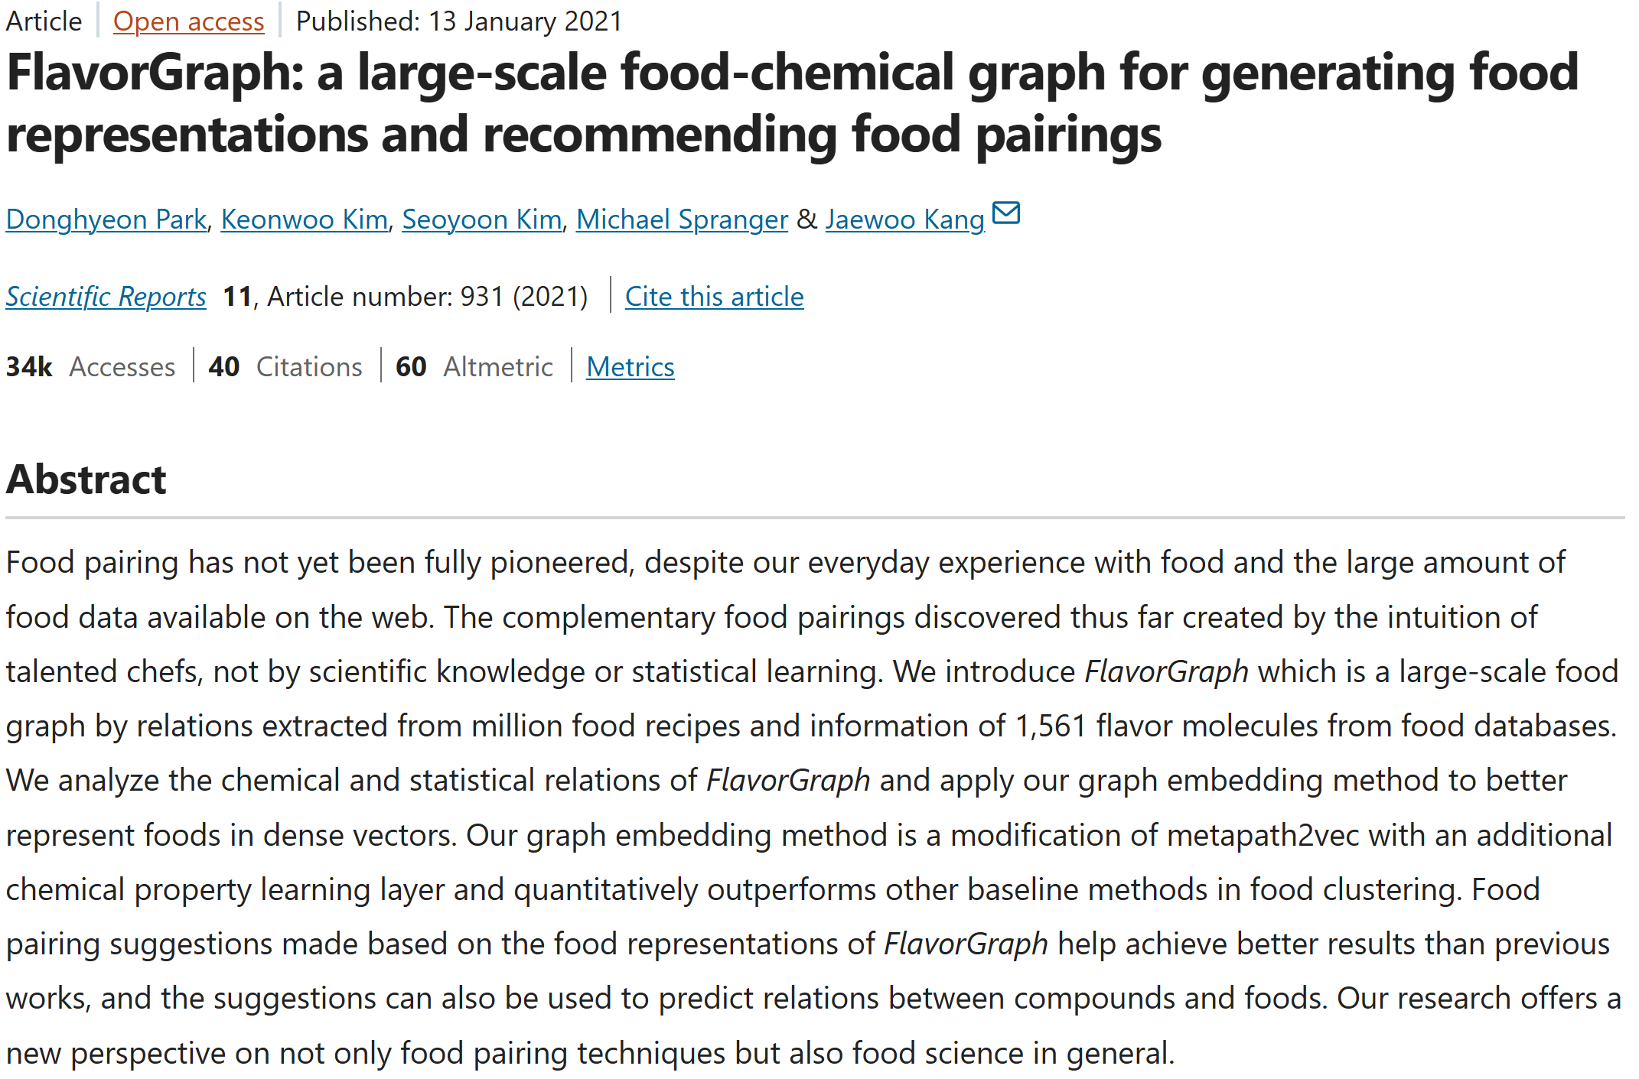

Slide 3
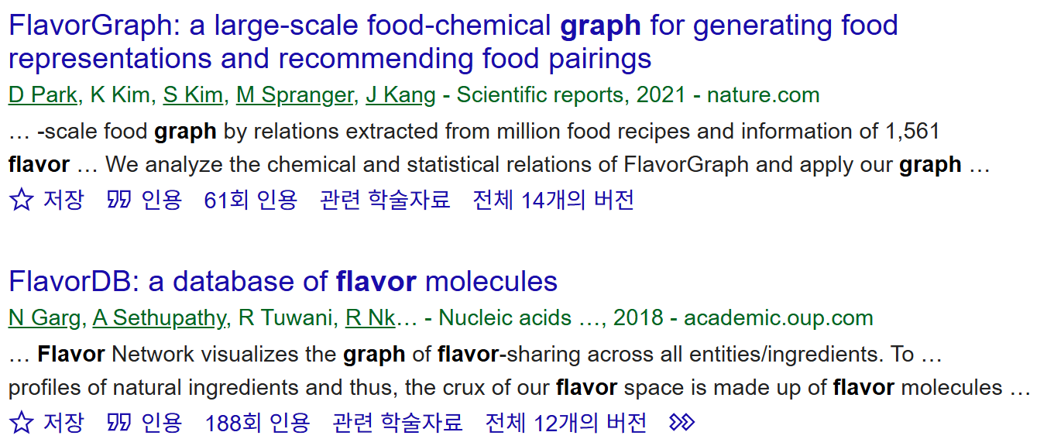

Slide 4
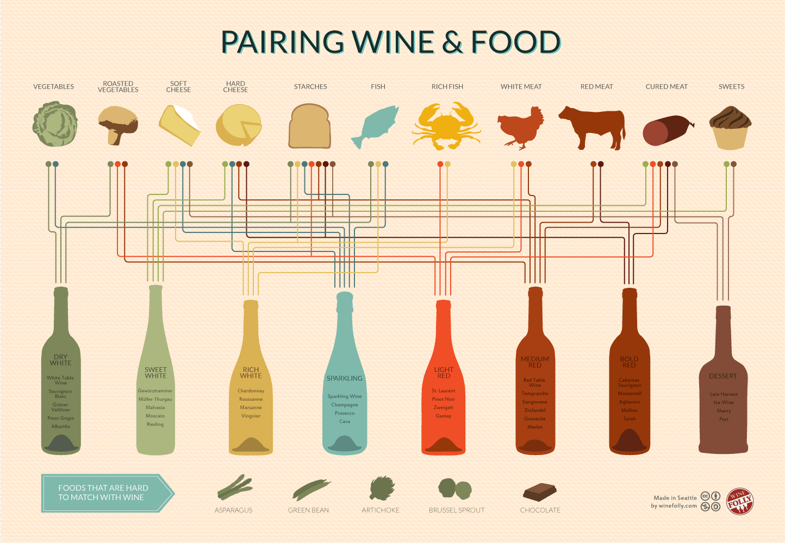
wine-and-food-pairing-chart.png (1444×1000)

Slide 5




Slide 6
Key Questions
How can we obtain better food representations?
How can we apply improved food representations to food pairing?

Slide 7
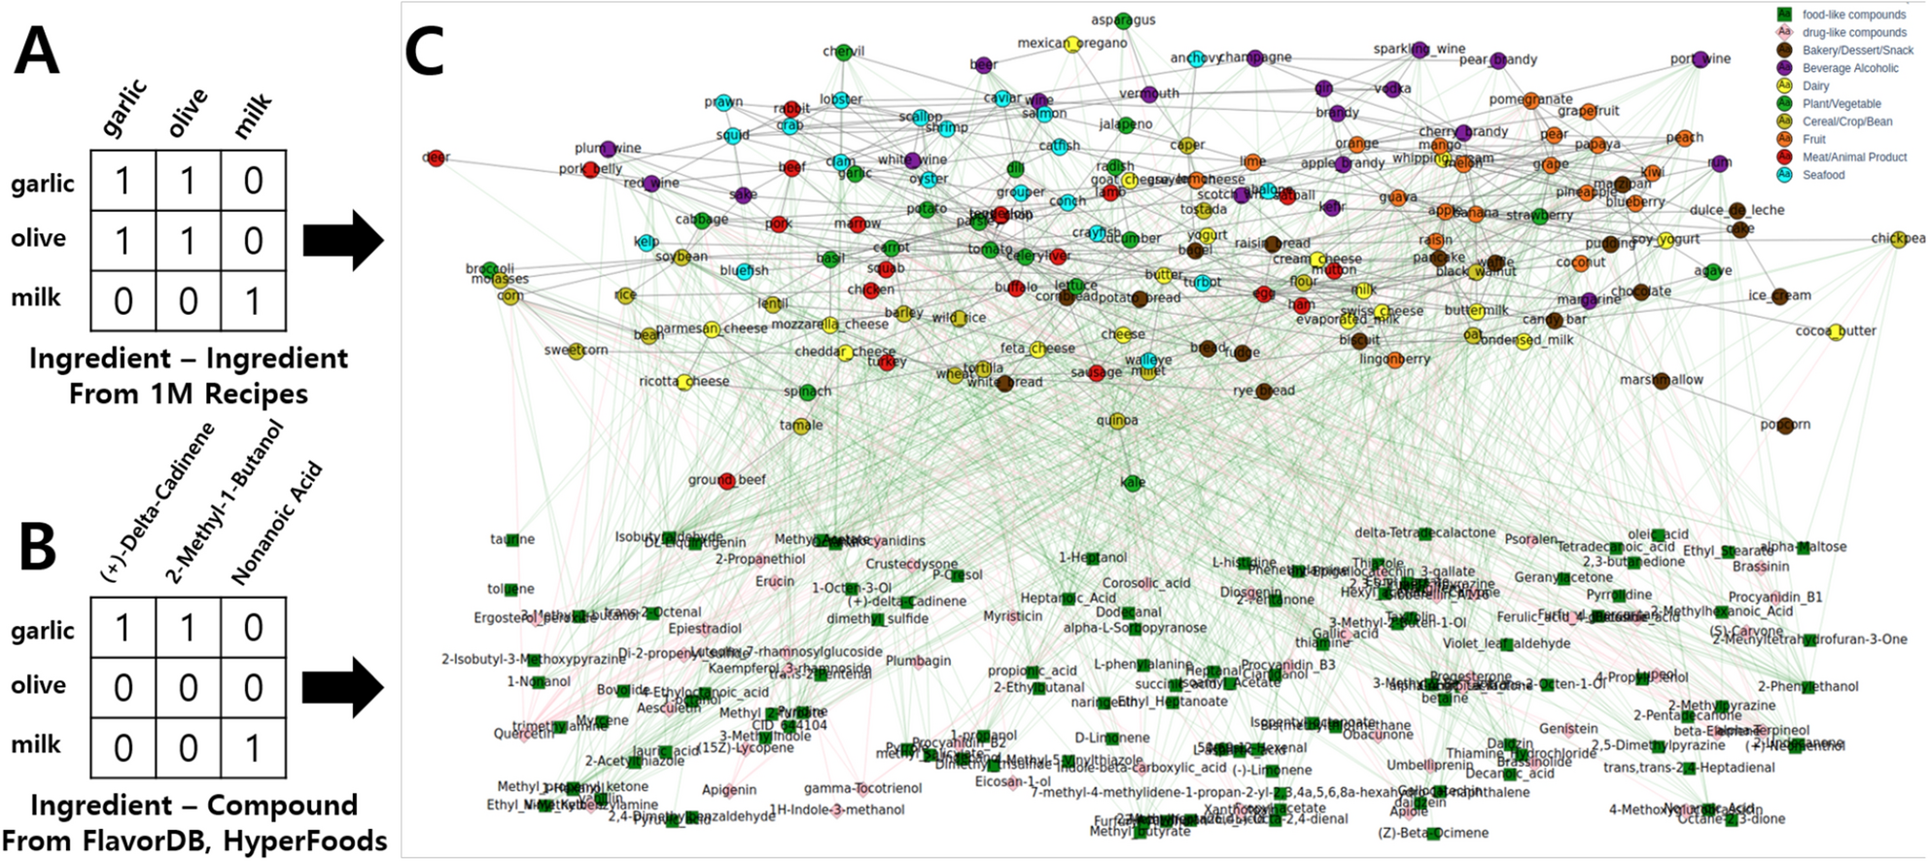

Slide 8
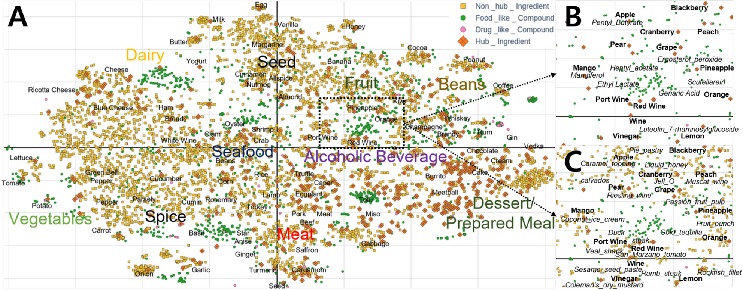

Slide 9
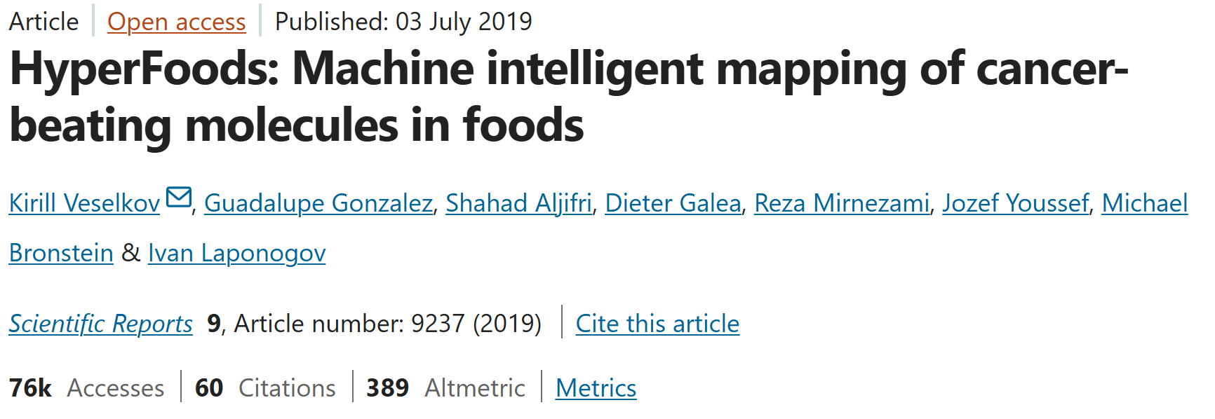
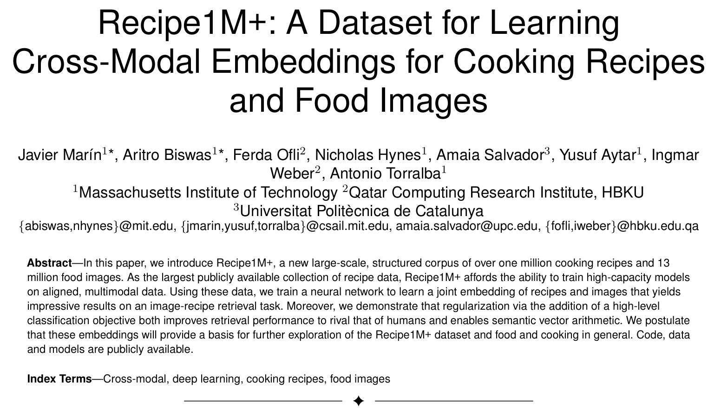
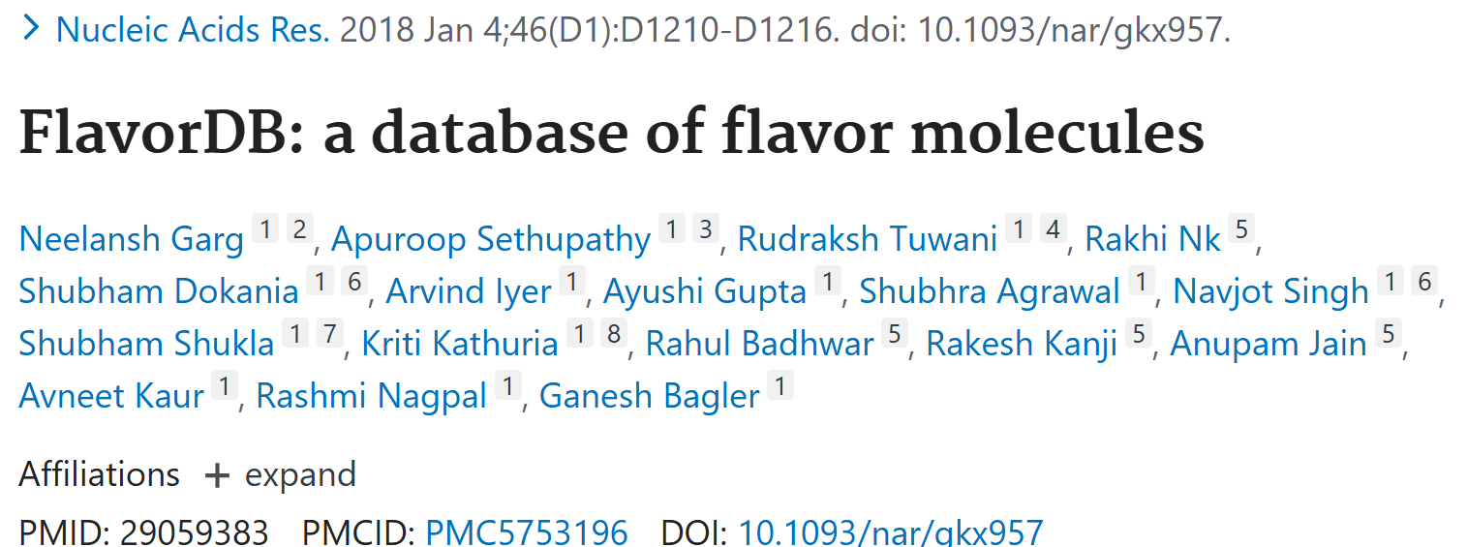
Dataset

Slide 10
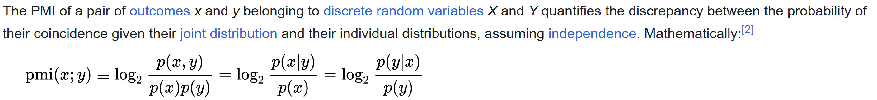
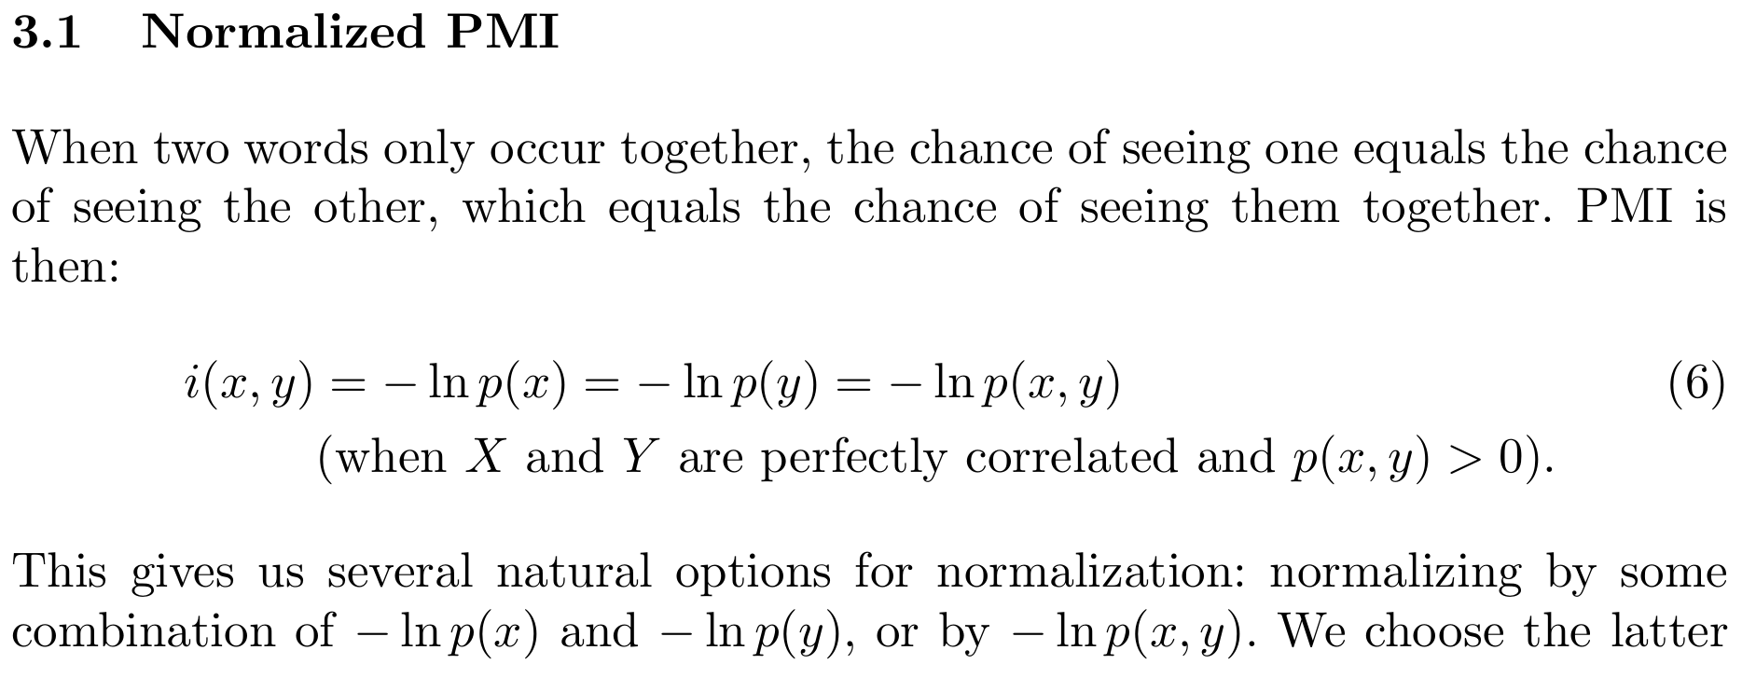
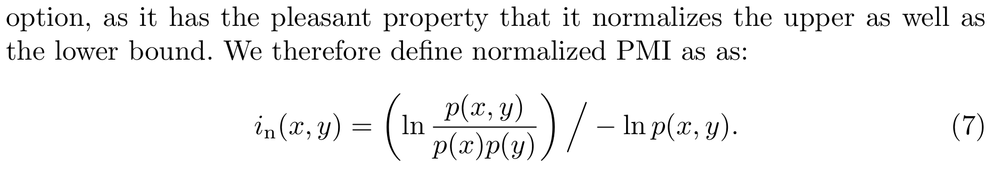
NPMI

Slide 11
Food-food relations
Each ingredient appears more than 20 times in Recipe1M and both appear more than 5 times in the same recipe.
The calculated NPMI score is at least 0.25.

Slide 12
FlavorGraph
6653 nodes
(food ingredients)
1646 nodes
(chemical compounds)
147,179 edges

Slide 13
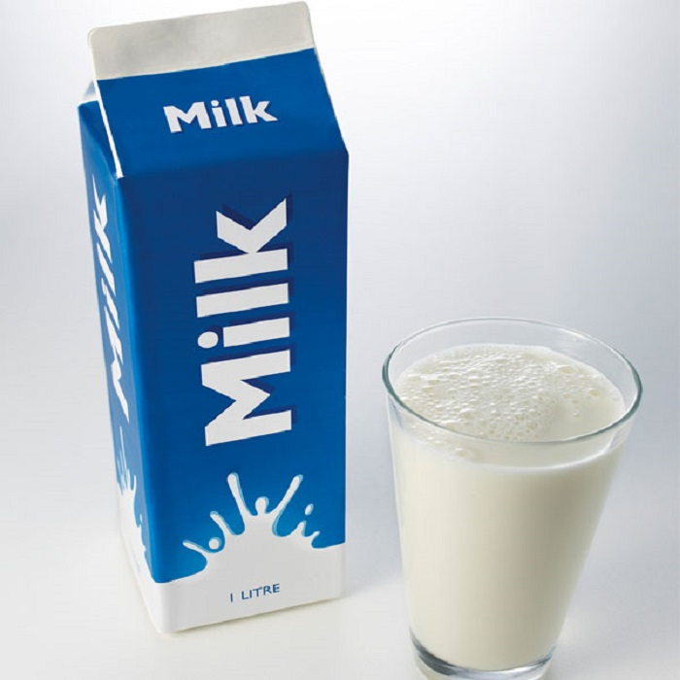
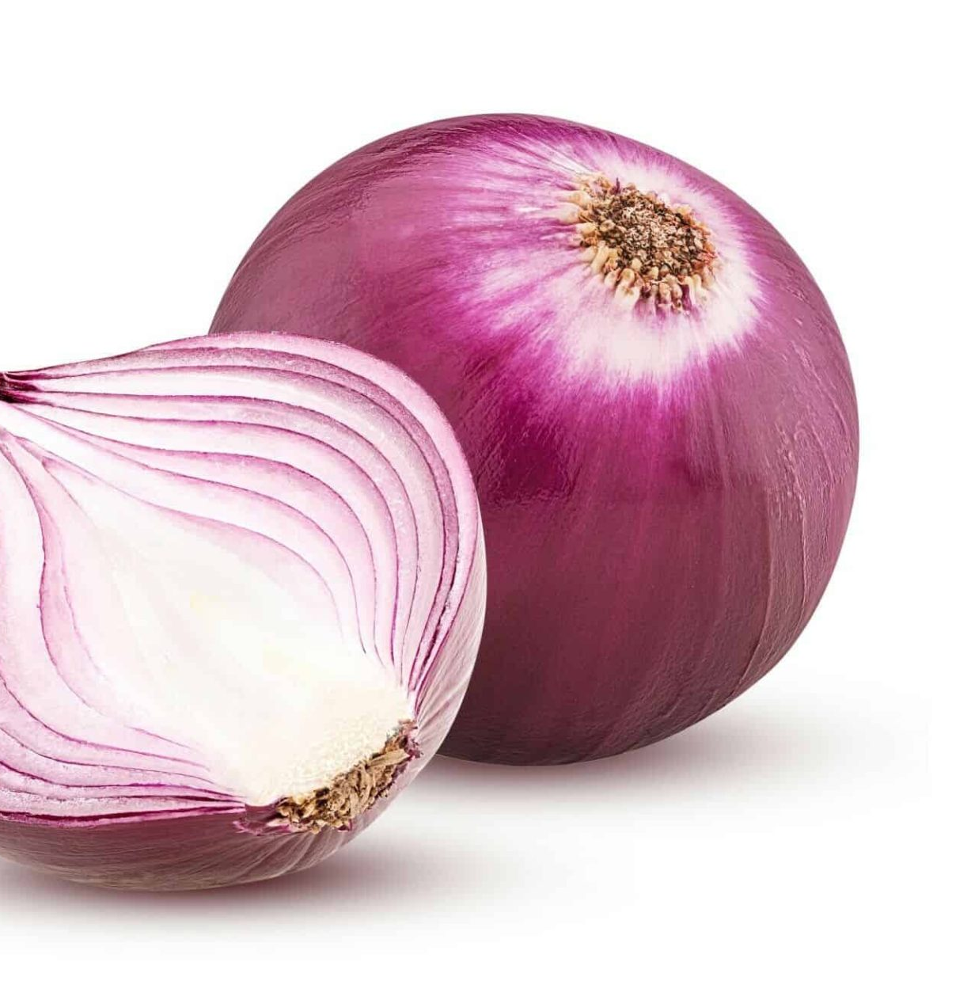
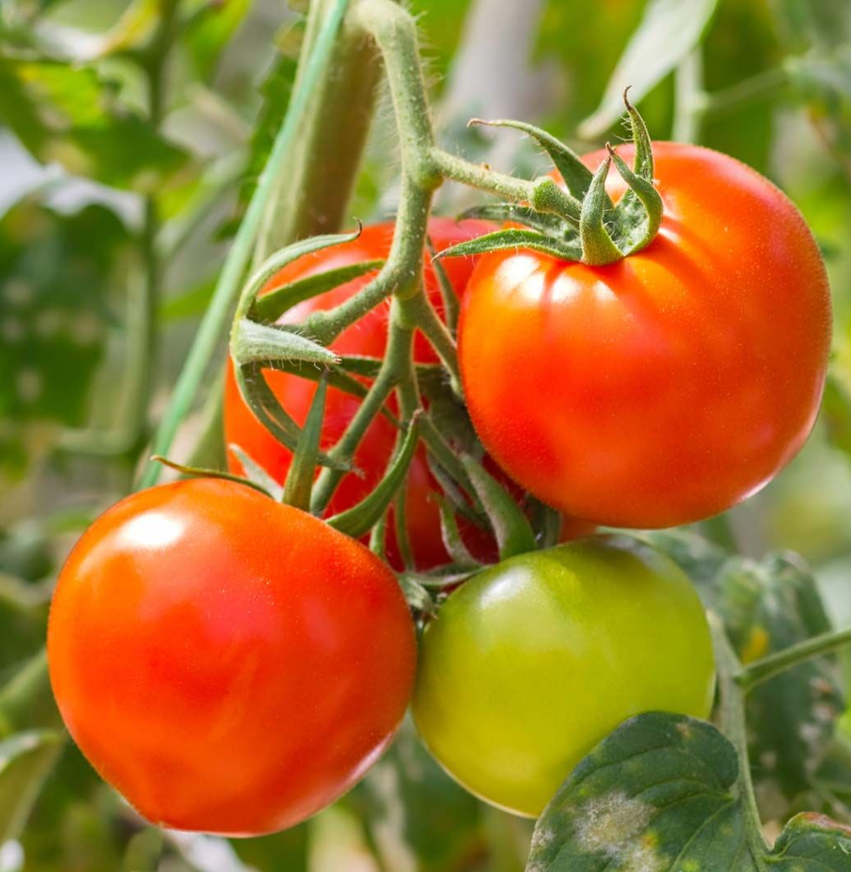
Food Ingredients

Slide 14
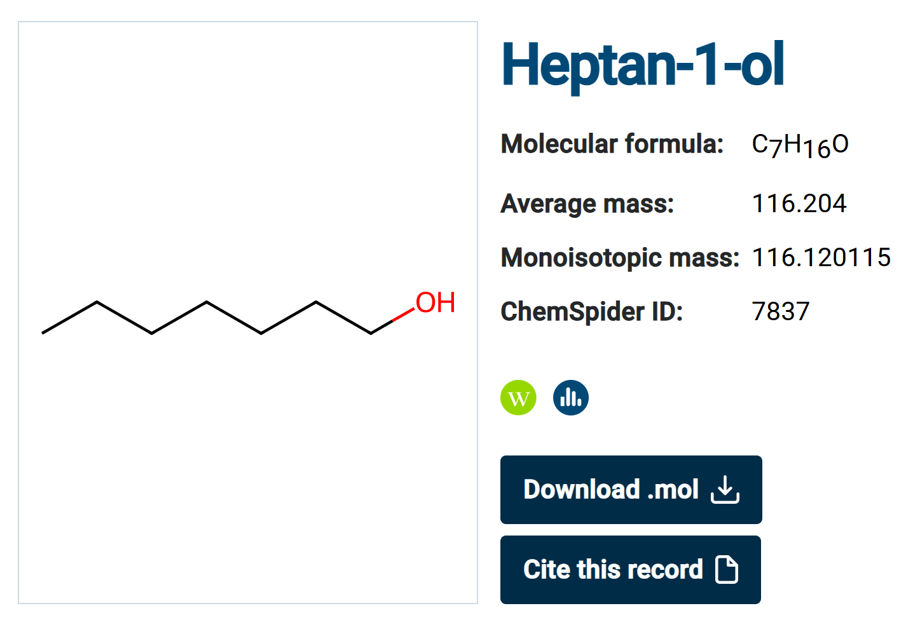
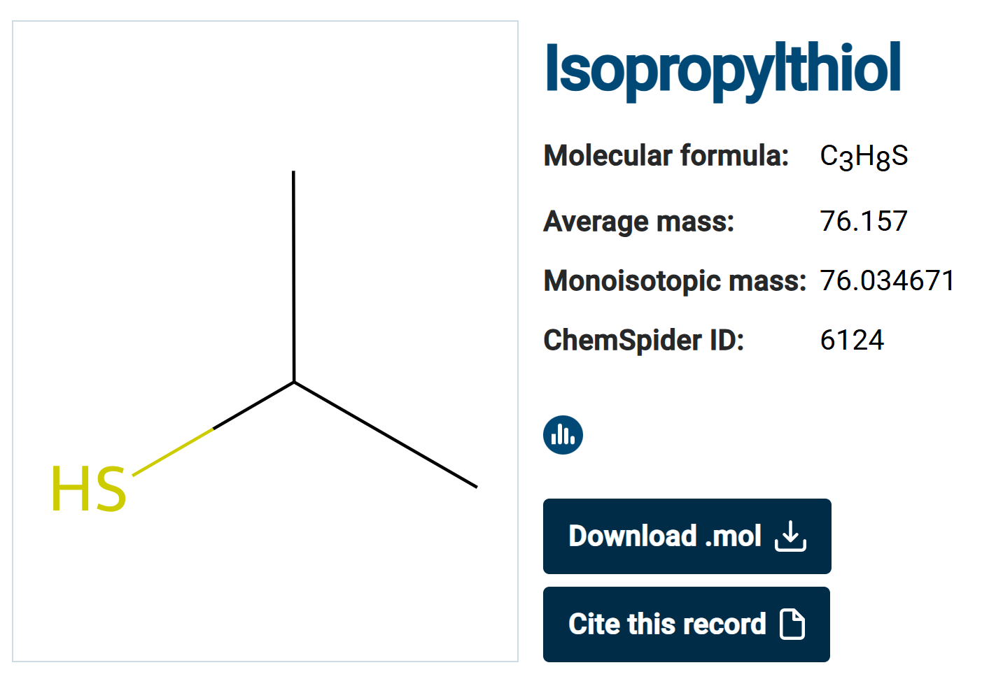
Food & Drug like Compounds
ChemSpider: Search and Share Chemistry - Homepage

Slide 15
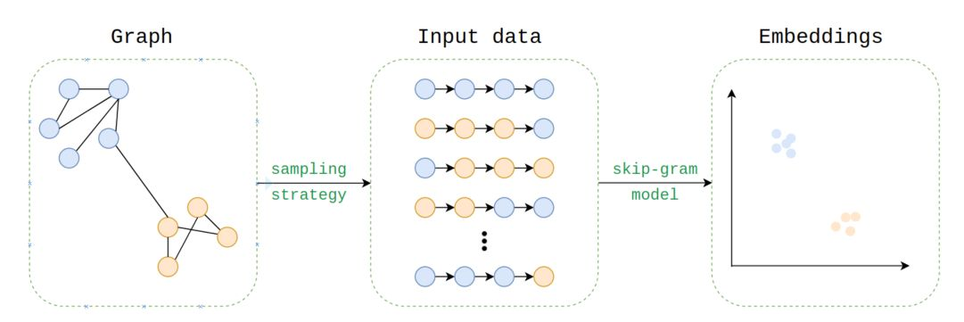
Graph Embedding -

Slide 16
Preliminary analysis on food pairings with chemical compound information and recipe co-occurrence

Slide 17
Dataset

Slide 18
Hypotheses
Whether the co-occurrence probability of two ingredients in a large corpus indicate good pairings.
Whether the high number of overlapping chemical compounds indicate good pairings.

Slide 19
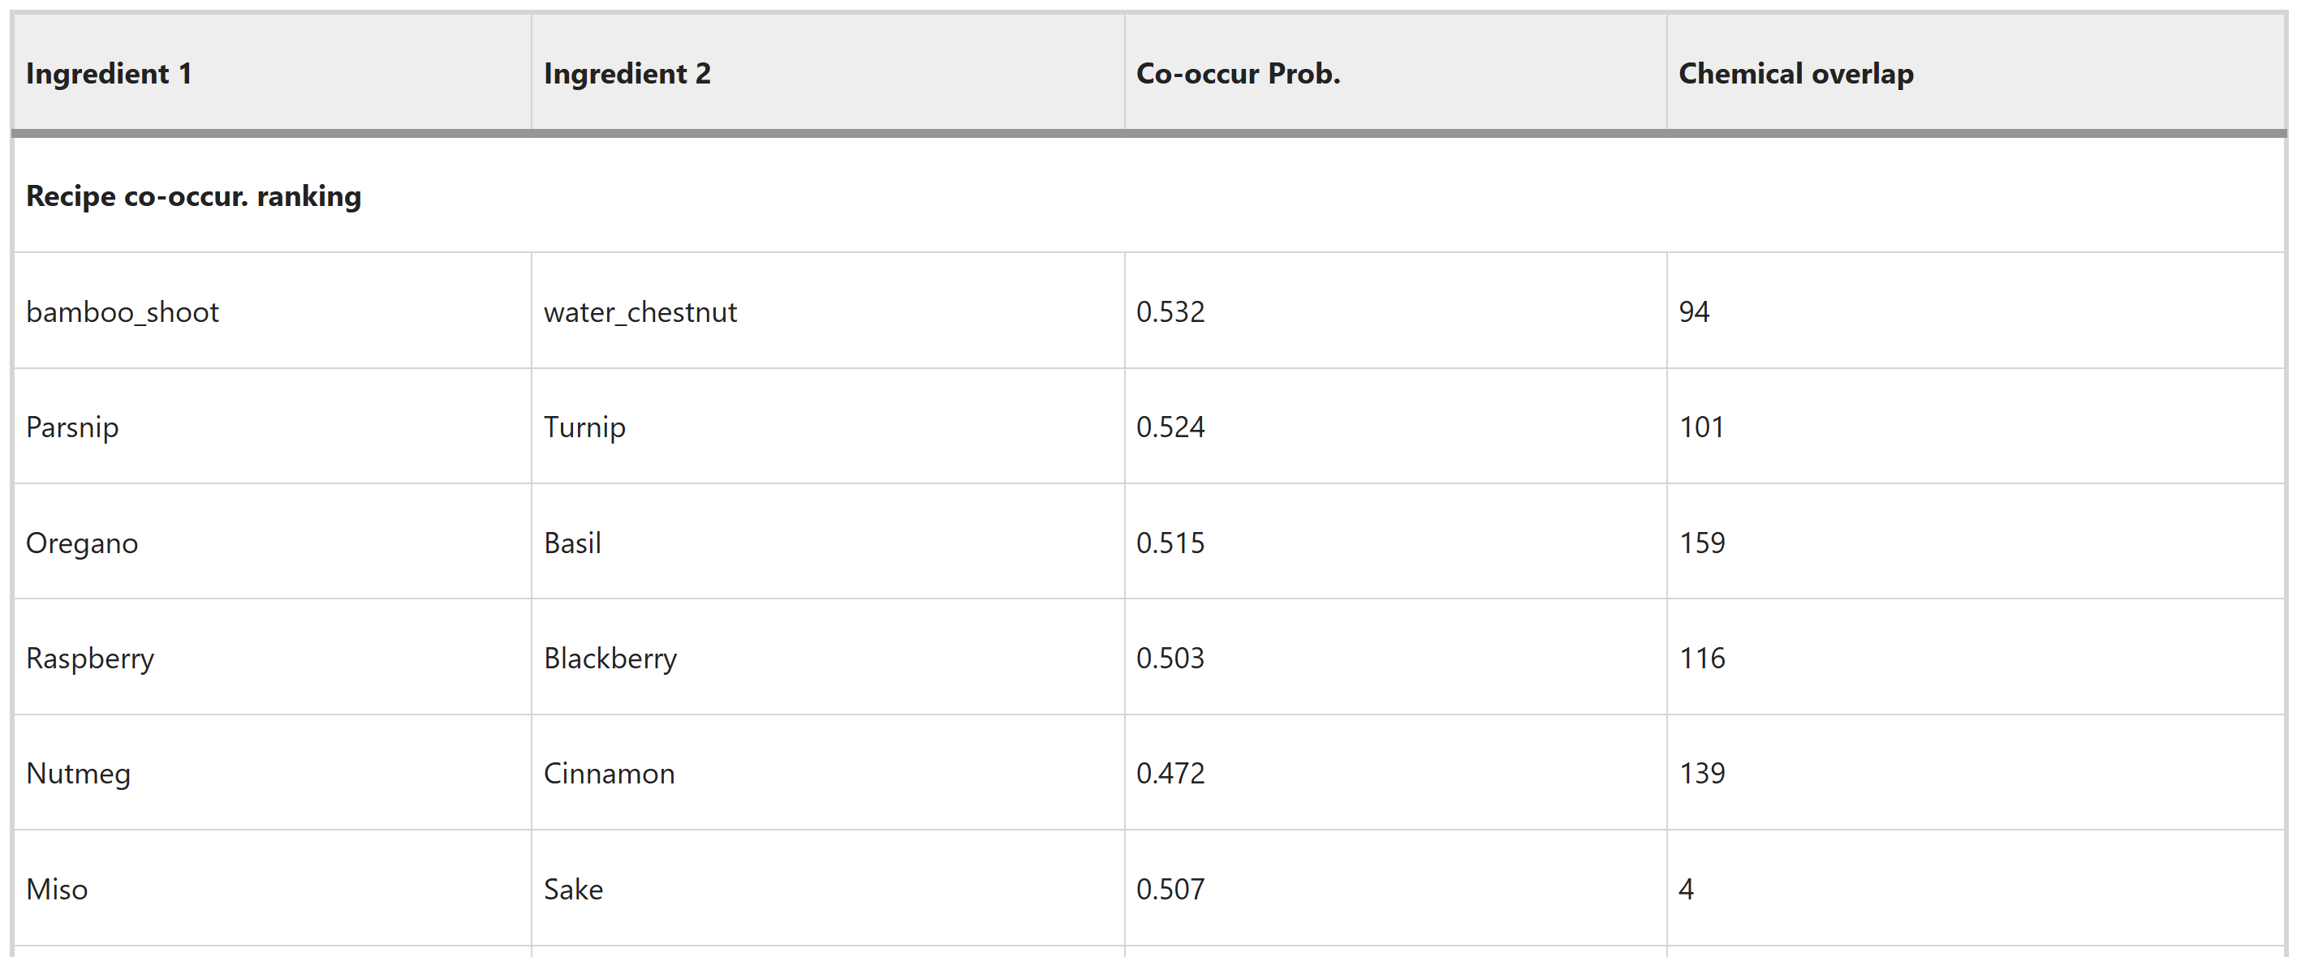
Recipe co-occurrence based pairing ranking

Slide 20
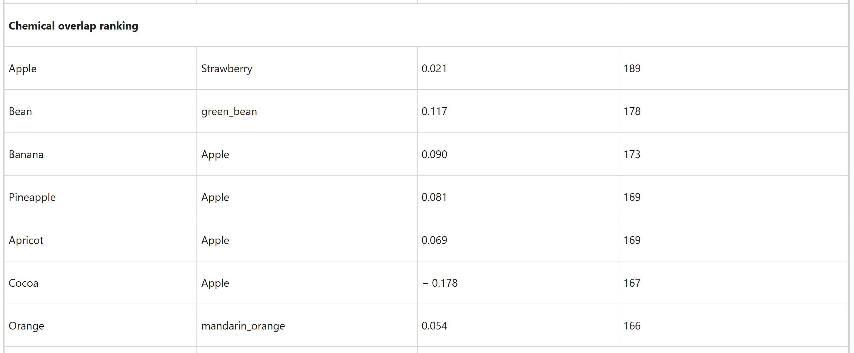
Chemical overlap-based ranking

Slide 21
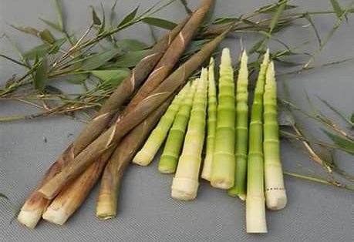
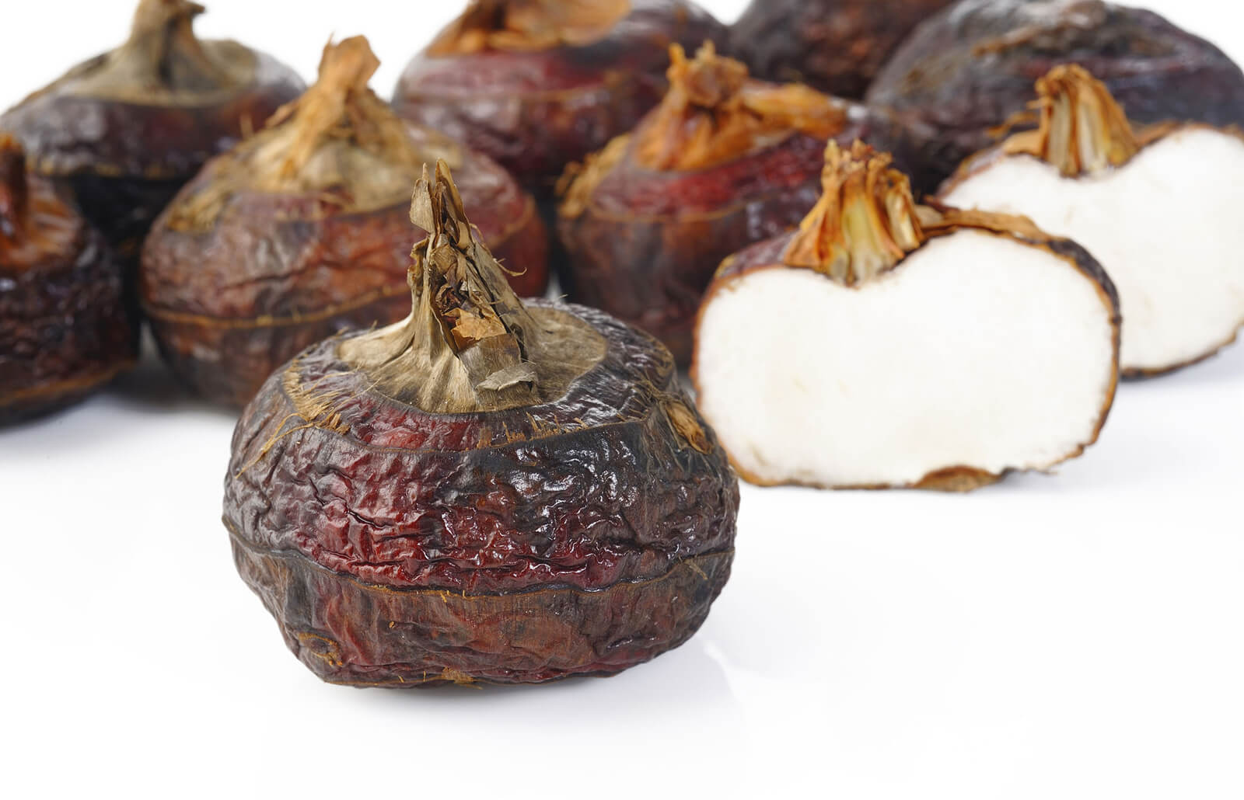
Congruent Pairings

Slide 22
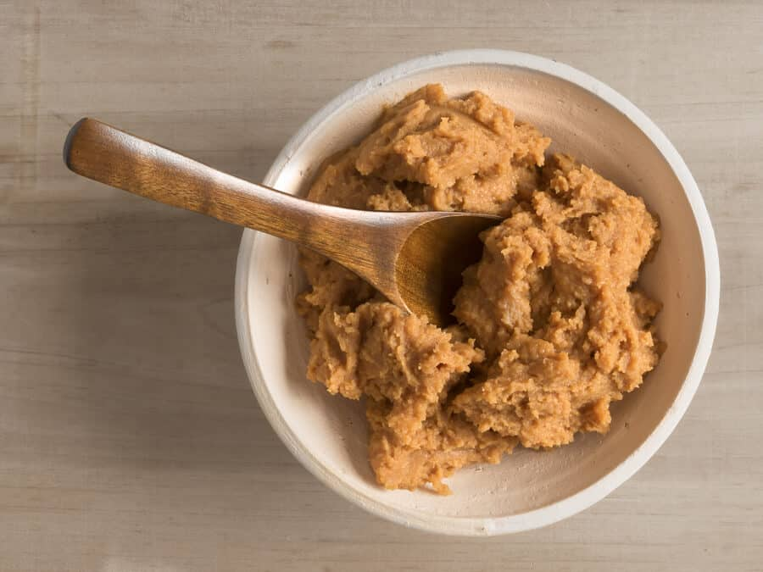

Complementary Pairings

Slide 23
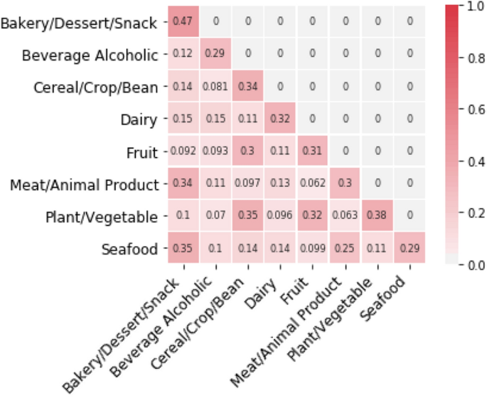
Chemical structure similarity between two categories

Slide 24
Result

Slide 27
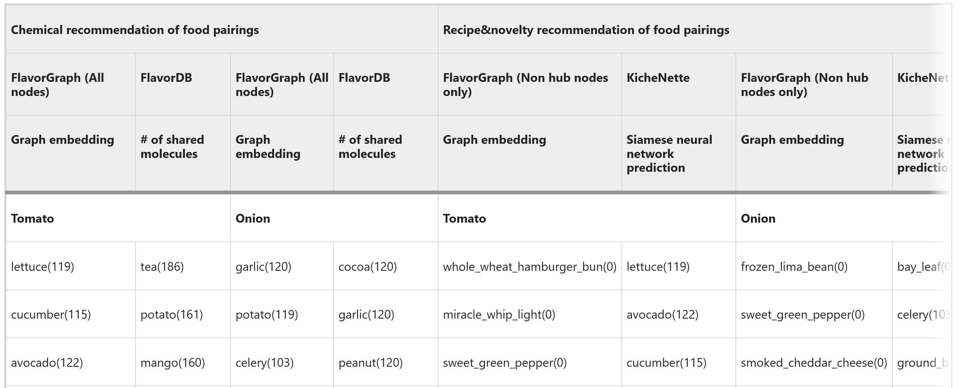
Food Pairing

Slide 28
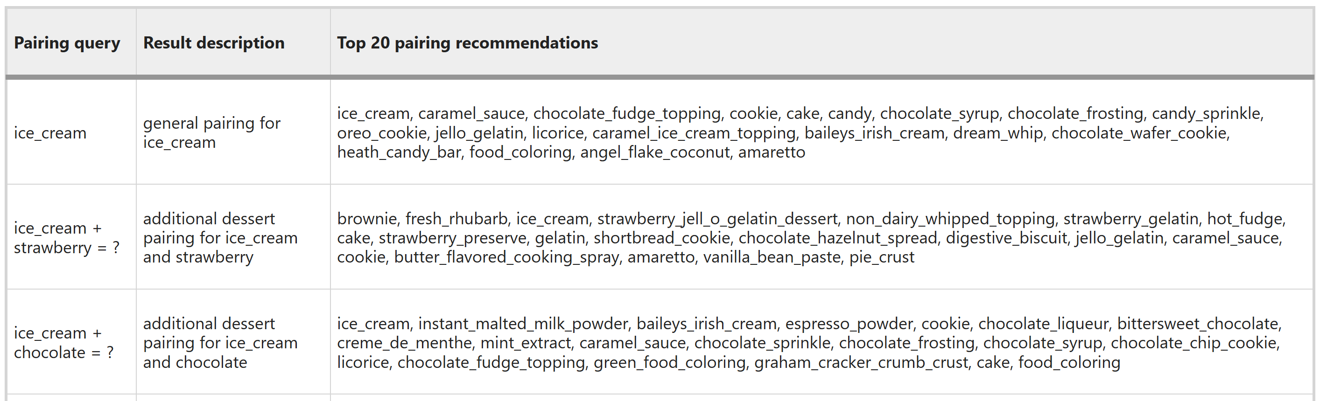
Pairing recommendations
Korean Word2Vec

Slide 29
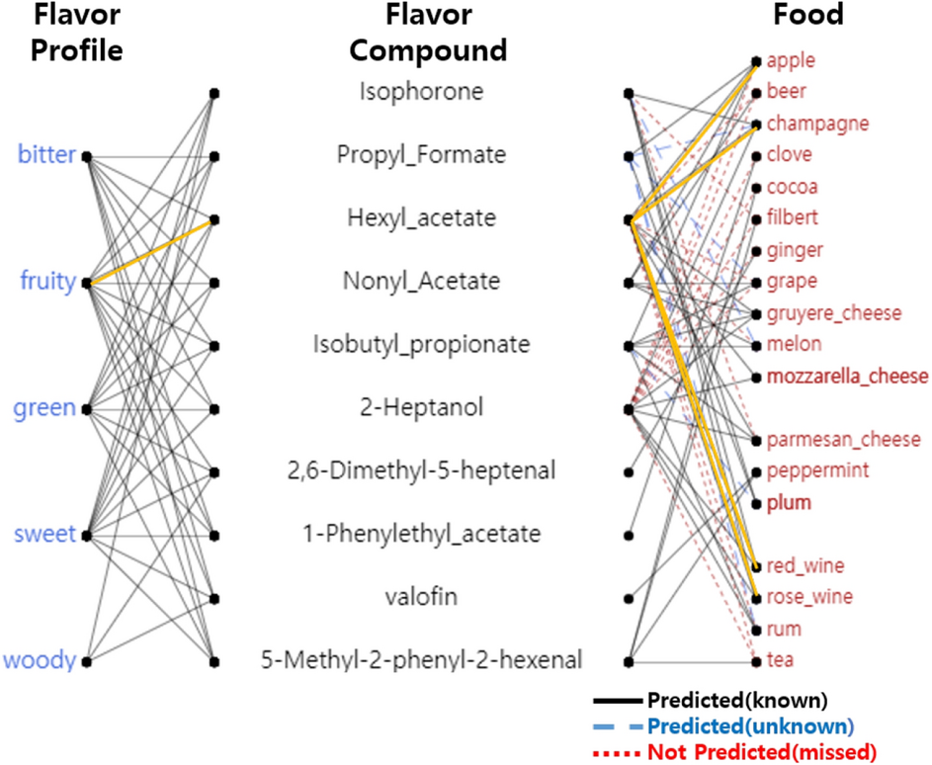

Slide 30
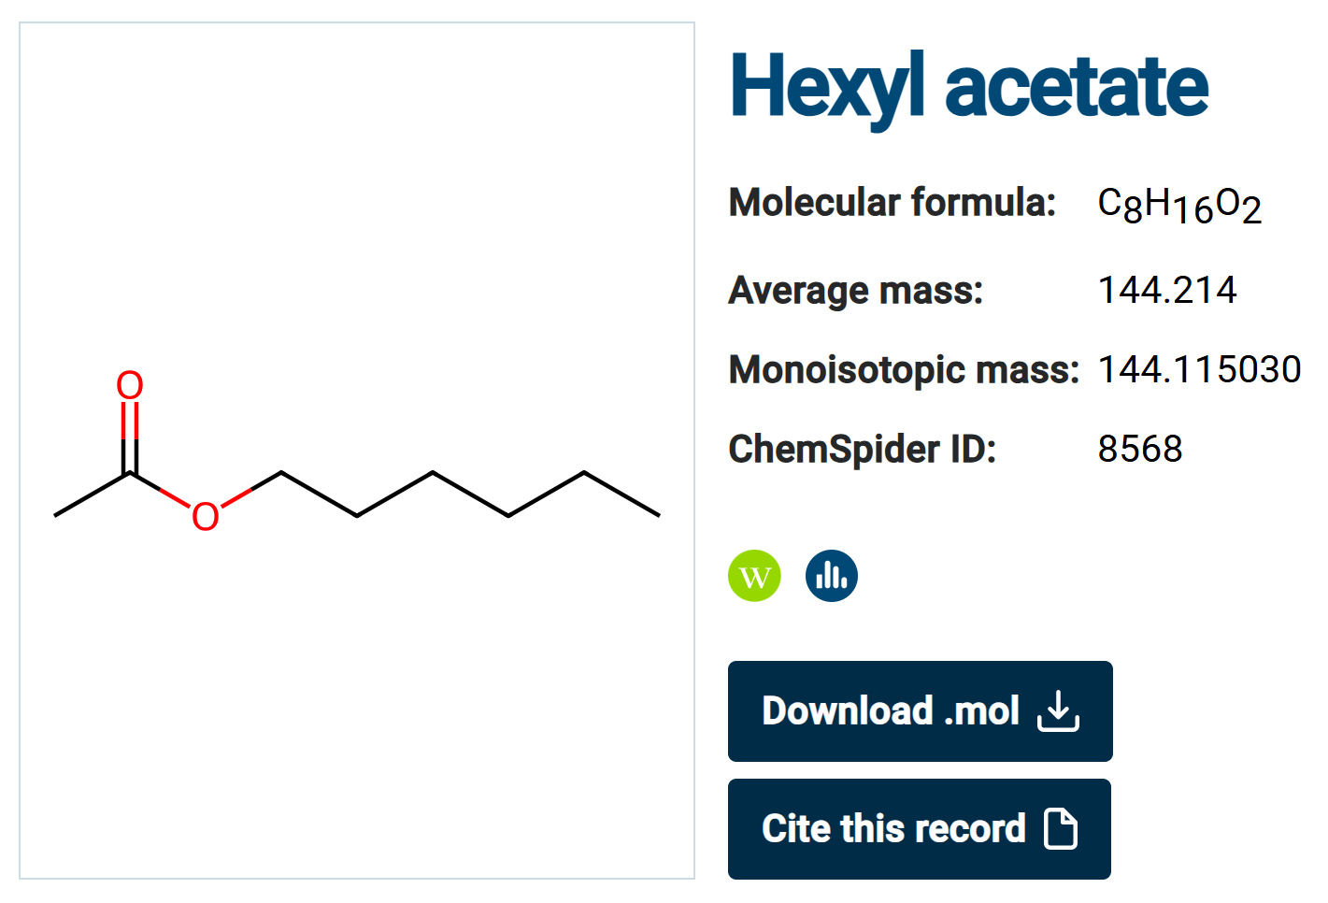

Slide 31
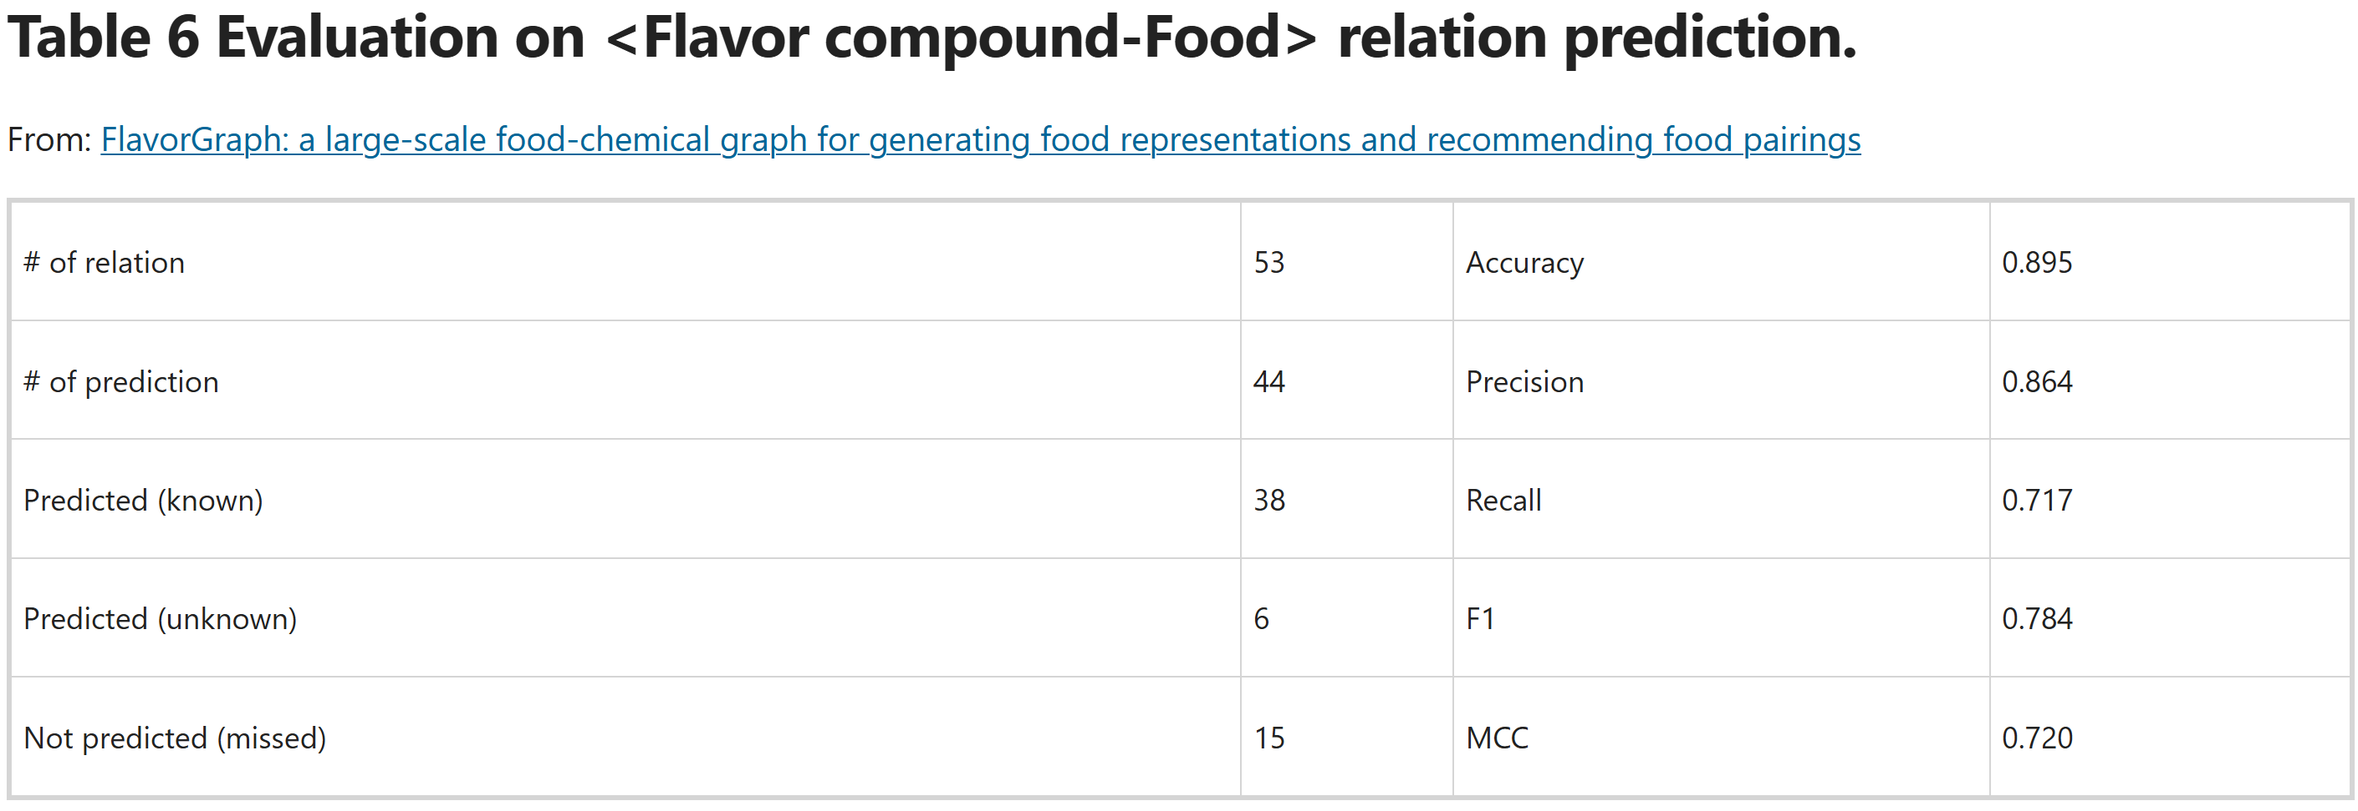

Slide 32
Limitations
More food-related information is needed to better understand food. This work combines only recipe co-occurrence information and chemical information.
Since the metapath-based graph embedding method uses unsupervised learning, it is difficult to evaluate the food repre sentations.
Last, the food pairing recommendations and food-compound relation predictions made in this study have not yet been scientifically evaluated because there is no single correct answer set that can be used for verifying such results.

Slide 33
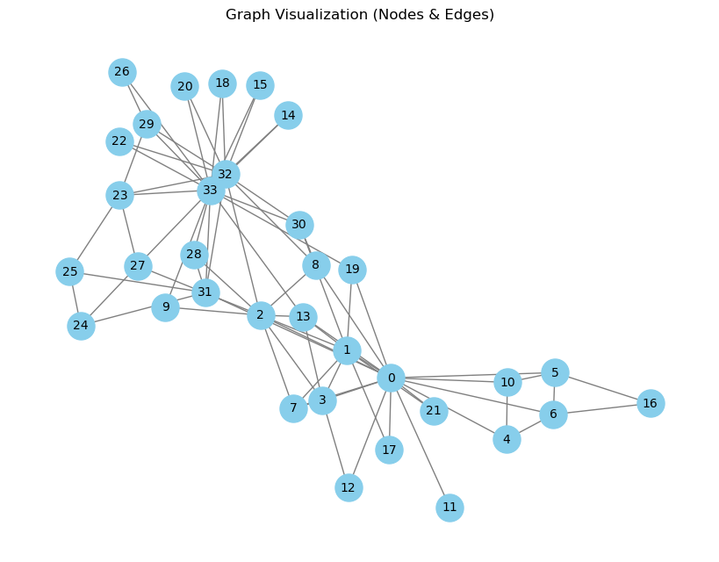
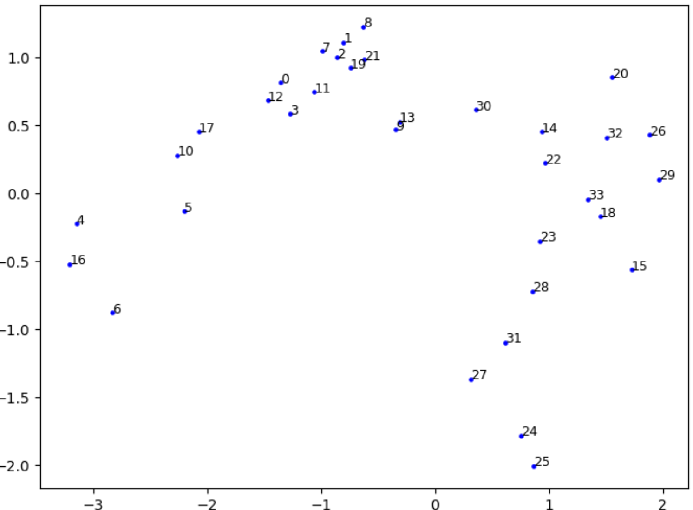
At The Next Seminar
Graph
Graph embedding
Skip-gram
Node2Vec
Metapath2Vec
Thank You!

Slide 34
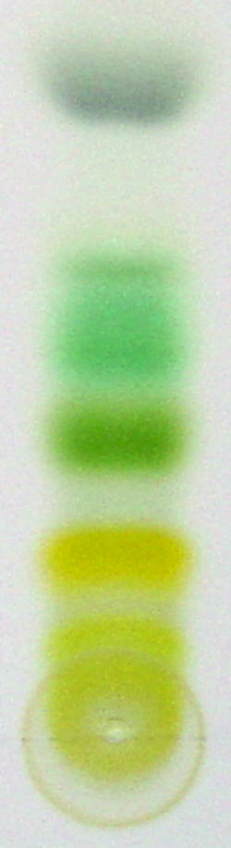
Chromatography

